Slide 1
GLND Randomization
Local GLND Study Site Pharmacist Instructions
DO NOT PRINT OUT AND USE THE FORM IN THIS PRESENTATION

Slide 2
1. The DCC will process the faxed forms that the local GLND study site coordinator has filled out. If ALL the data checks out,
the DCC will fax to the GLND Study
Site Pharmacist and to Susan Rogers the
Treatment Assignment Envelope Code
(an example of this fax is provided).

Slide 3
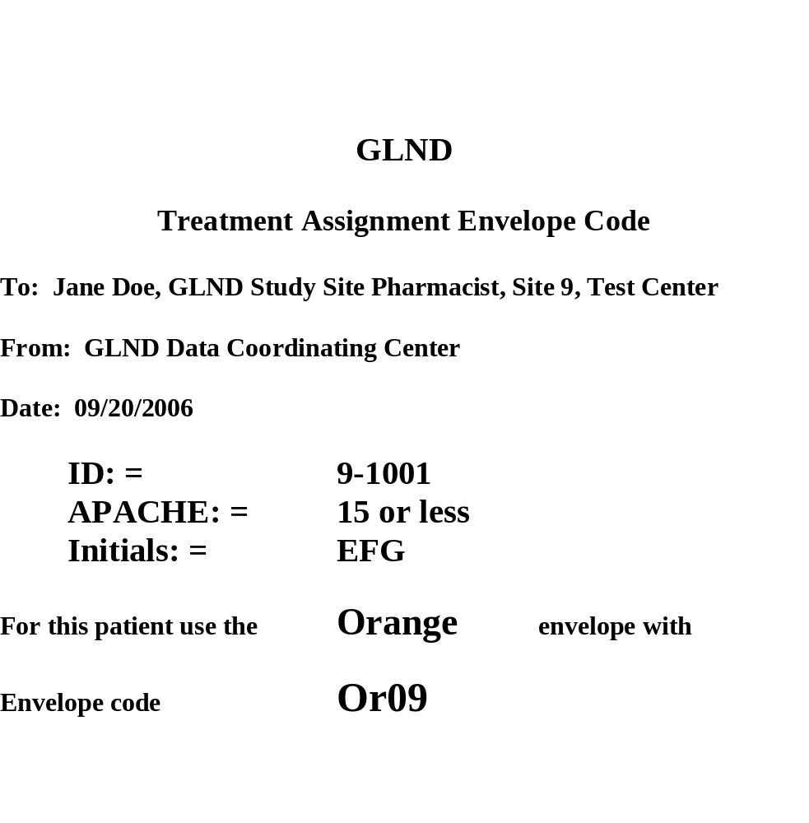
ONLY THE LOCAL GLND STUDY SITE PHARMACIST
WILL RECEIVE THIS FAX

Slide 4
2. The GLND Study Site Pharmacist will
open the appropriate envelope and remove the peel-off label with the treatment assignment from the card and place it on the Pharmacy Confirmation form. Examples of envelopes and cards can be found in the front pocket of the Pharmacy Manual and Procedures. The pharmacist will fill out the rest of the form and fax it to the DCC.
This will complete the randomization
loop.

Slide 5
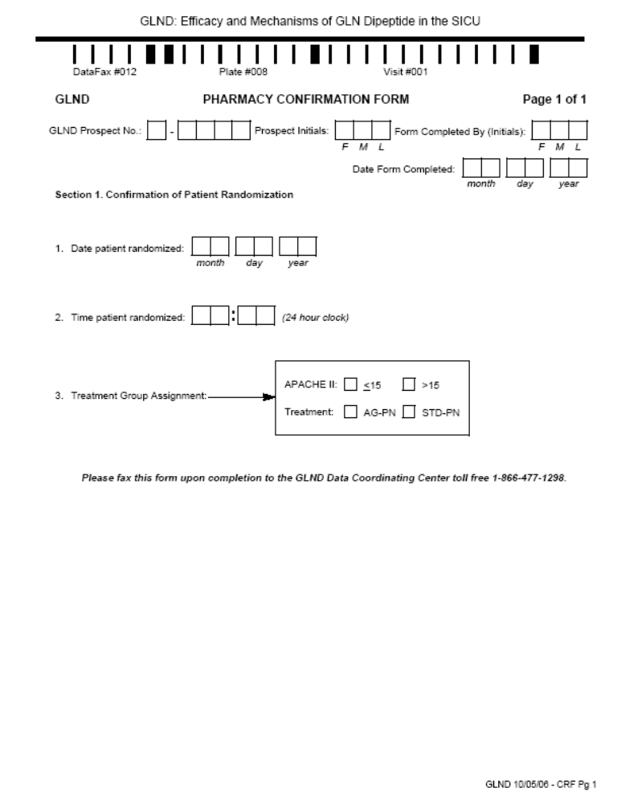

Slide 6
The peel-off label on the card in the randomization envelope will be similar to this:
Code: Or09
APACHE II : <=15
Treatment: AG-PN

